Slide 1
Cloud Computing:
Security, Privacy and Trust Aspects across Public and Private Sectors
Industry Perspective
Marco Casassa Mont
(marco.casassa-mont@hp.com)
Senior Researcher
Systems Security Lab, HP Labs, Bristol
RAND Europe – Cloud Computing 2010
10 September 2010

Slide 2
Outline
Background on Cloud Computing
Impact on Enterprise’s Security Lifecycle Management
Current Trends, Requirements and Cloud Computing Initiatives
Future Directions: related R&D Work by HP Labs
Conclusions

Slide 3
Outline
Background on Cloud Computing
Impact on Enterprise’s Security Lifecycle Management
Current Trends, Requirements and Cloud Computing Initiatives
Future Directions: related R&D Work by HP Labs
Conclusions

Slide 4
Cloud Computing: Definition
No Unique Definition or General Consensus about what Cloud Computing is …
Different Perspectives & Focuses (Platform, SW, Service Levels…)
Flavours:
  Computing and IT Resources Accessible Online
  Dynamically Scalable Computing Power
  Virtualization of Resources
  Access to (potentially) Composable & Interchangeable Services
  Abstraction of IT Infrastructure
  → No need to understand its implementation: use Services & their APIs
  Related “Buzzwords”: Iaas, PaaS, SaaS, EaaS, …
  Some current players, at the Infrastructure & Service Level:
  Salesfoce.com, Google Apps, Amazon, Yahoo, Microsoft, IBM, HP, etc.

Slide 5
Cloud Service Layers
Service Users
Service
Providers
Cloud End-User Services (SaaS)
Cloud Platform Services (PaaS)
Cloud
Providers
Cloud Infrastructure Services (IaaS)
Physical Infrastructure
Source: HP Labs, Automated Infrastructure Lab (AIL), Bristol, UK - Peter Toft

Slide 6
Cloud Computing: Models
Cloud
Provider #1
On Demand
CPUs
Printing
Service
CRM
Service
Office
Apps
Data
Storage
Service
User
…
Enterprise
Cloud
Provider #2
Backup
Service
Service
ILM
Service
Employee
Service
Service 3
Service
Business
Apps/Service
…
…
The
Internet
Internal Cloud
…

Slide 7
Outline
Background on Cloud Computing
Impact on Enterprise’s Security Lifecycle Management
Current Trends, Requirements and Cloud Computing Initiatives
Future Directions: related R&D Work by HP Labs
Conclusions

Slide 8
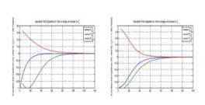
Today Security Management Lifecycle
Economics/
Threats/
Investments
Policy, process, people, technology
& operations
Governance and Risk -> Develop Policy - > Technology and Operations -> Infrastructure -> Risk, Assurance and Compliance ->
Malware
Exploit
Available
Vulnerability
Disclosed
Patch
Available
Malware
Reports?
Exposed?
Vulnerability
Assessment
Y
N
N
Y
Test
Solution
Patch
Available?
Accelerate?
Early
Mitigation?
N
Y
Y
Y
Patch
Deployment
Workaround
Available?
Deploy
Mitigation
Accelerated
Patching
Y
Implement
Workaround
Emergency
Patching
Security
Analytics
Assurance &
Situational Awareness
Trusted Infrastructure

Slide 9
Stewardship in the Cloud Ecosystem
Implications
Governance and Risk -> Develop Policy - > Technology and Operations -> Infrastructure -> Risk, Assurance and Compliance ->
Governance and Risk -> Develop Policy - > Technology and Operations -> Infrastructure -> Risk, Assurance and Compliance ->
Governance and Risk -> Develop Policy - > Technology and Operations -> Infrastructure -> Risk, Assurance and Compliance ->
Service
Consumer
SaaS
Provider
IaaS
Provider
Source: HP Labs, Systems Security Lab (SSL), Bristol, UK – Simon Shiu, Adrian Baldwin

Slide 10


The Enterprise Cloud Consumer
Business
IT Dept
CISO/CIO
Public Cloud
staff
Fulfill
need
infrastructure
Private/
Community
Cloud
Source: HP Labs, Systems Security Lab (SSL), Bristol, UK – Simon Shiu, Adrian Baldwin

Slide 11
Cloud Computing: Implications
Enterprise:
Paradigm Shift from “Close & Controlled” IT Infrastructures and Services to Externally Provided Services and IT Infrastructures
Private User:
Paradigm Shift from Accessing Static Set of Services to Dynamic & Composable Services
General Issues:
  Assurance (and Trust) about Security and Business Practices
  Potential Loss of Control (on Data, Infrastructure, Processes, etc.)
  Data & Confidential Information Stored in The Clouds
  Management of Identities and Access (IAM) in the Cloud
  Compliance to Security Practice and Legislation
  Privacy Management (Control, Consent, Revocation, etc.)
  New Threat Environments
  Reliability and Longevity of Cloud & Service Providers

Slide 12
Outline
Background on Cloud Computing
Impact on Enterprise’s Security Lifecycle Management
Current Trends, Requirements and Cloud Computing Initiatives
Future Directions: related R&D Work by HP Labs
Conclusions

Slide 13
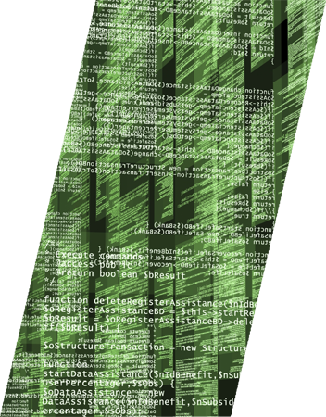
Current Trends of Relevance
1. Increasing Adoption of Services in the Cloud
2. (IT) Consumerisation of the Enterprise

Slide 14
Adoption of Services in the Cloud

Slide 15
Services in the Cloud [1/2]
Growing adoption of IT Cloud Services by People and Companies,
in particular SMEs (cost saving, etc.)
Includes:
  Datacentre consolidation and IT Outsourcing
  Private Cloud/Cloud Services
  Public Cloud Services
  - Amazon, Google, Salesforce, …
Gartner predictions about Value of
Cloud Computing Services:
  2008 : $46.41 billion
  2009 : $56.30 billion
  2013 : $150.1 billion (projected)
NOTE: these Trends are less obvious for Medium-Large Organisations and Gov Agencies
Org
Org
Org
Cloud
Computing
Services

Slide 16
Services in the Cloud [2/2]
Some statistics about SME’s usage of Cloud Services
(Source: SpiceWorks):
Cloud initiatives from Governments
→ see UK g-Cloud Initiative
http://johnsuffolk.typepad.com/john-suffolk---government-cio/2009/06/government-cloud.html
Org
Org
Org
Data Backup : 16% Email : 21.2% Application : 11.1% VOIP : 8.5% Security : 8.5% | CRM : 6.2% Web Hosting : 25.4% eCommerce : 6.4% Logistics : 3.6% Do not use : 44.1%
Cloud
Computing
Services

Slide 17
Personal Cloud Services
User-driven, Personal Cloud Services:
  - Multiple Interconnected Devices
  - Multiple Online Services
  - Multiple Data Sources and Stores
Forrester’s Prediction (by Frank Gillet):
  - Growing role of Personal Cloud Services and
  Decreasing Relevance of traditional Operating Systems …

Slide 18
Opportunities and Threats
Opportunities:
  Cost cutting
  Further enabler of IT Outsourcing (medium-large organisations)
  Better & cheaper services
  No lock-in situation with a service provider
  …
Threats:
  Potential lack of control on Data and Processes
  Proliferation of data and PII information
  Reliability and Survivability Issues
  Data protection and Privacy
  Reliance on third party …

Slide 19
(IT) Consumerisation of the Enterprise

Slide 20
Traditional (IT) Enterprise Model
Key role of CIOs/CISOs, Legal Departments, etc. in defining Policies and Guidelines
Controlled and Centralised IT Provisioning
IT Infrastructures, Services and Devices Managed by the Organisation
Enterprise
Corporate IT (security) Policies,
Provisioning & Management
Storage
Corporate
Devices
Servers
IT Services

Slide 21

Towards Consumerization of (IT) Enterprise
New Driving Forces:
  IT Outsourcing
  Employees using their own Devices at work
  Adoption of Cloud Services by Employees and the Organization
  Blurring Boundaries between Work and Personal Life
  Local Decision Making …
Cloud
Services
Services
Storage
Enterprise
IT Services
Storage
Personal
Devices
Servers
Servers

Slide 22
Opportunities and Threats
Opportunities for Employees and Organisations:
  Empowering users
  Seamless experience between work and private life
  Cost cutting
  Better service offering
  Transformation of CIO/CISO roles …
Threats:
  Enterprise data stored all over the places: Potential Data losses …
  Lack of control by organisation on users’ devices: potential security threats
  …

Slide 23
Cloud Computing: Requirements
Simplified Management of Identities and Credentials
Need for Assurance and Transparency about:
  (Outsourced) Processes
  Security & Privacy Practices
  Data Lifecycle Management
Compliance to Regulation, Policies and Best Practice
  Need to redefine what Compliance means in The Cloud
Accountability
Privacy Management: Control on Data Usage & Flows
Reputation Management

Slide 24
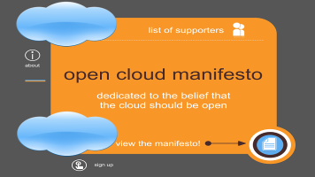


Cloud Computing: Initiatives
Recent General Initiatives aiming at Shaping Cloud Computing:
Open Cloud Manifesto
  Making the case for an Open Cloud
Cloud Security Alliance
  Promoting Best Security Practices for the Cloud
Jericho Forum
  Cloud Cube Model:
  Recommendations & (Security) Evaluation
  Framework
…

Slide 25
Outline
Background on Cloud Computing
Impact on Enterprise’s Security Lifecycle Management
Current Trends, Requirements and Cloud Computing Initiatives
Future Directions: related R&D Work by HP Labs
Conclusions

Slide 26

Some Future Directions
Trusted Infrastructure
Security Analytics
Cloud Stewardship Economics
Privacy Management

Slide 27
Trusted Infrastructure

Slide 28
Trusted Infrastructure
Ensuring that the Infrastructural
IT building blocks of the Enterprise
and the Cloud are
secure, trustworthy
and compliant with
security best practice
Trusted
Computing
Group (TCG)
/
Impact of
Virtualization
Trusted
Client
Infrastructure
Cloud
Provider #1
On Demand
CPUs
Printing
Service
CRM
Service
Office
Apps
Data
Storage
Service
User
Trusted
Client
Devices
…
Cloud
Provider #2
Enterprise
Backup
Service
Trusted
Client
Infrastructure
Trusted
Client
Infrastructure
ILM
Service
Service
Employee
Service
Service 3
Service
Business
Apps/Service
…
…
Internal Cloud
…
The
Internet
TCG: http://www.trustedcomputinggroup.org

Slide 29
Trusted Infrastructure: Trusted Virtualized Platform
HP Labs: Applying Trusted Computing to Virtualization
Personal
Client Persona
Secure Corporate (Government)
Client Persona
Services managed from cloud
Personal
Environment
Win/Lx/OSX
Home
Banking
E-Govt
Intf.
Remote
IT Mgmt
Corporate
Productivity
OS
Corporate
Production
Environment
OS
Corp.
Soft
Phone
Trusted Hypervisor
Trusted Personal
Client Appliances
online (banking, egovt) or local (ipod)
Trusted Corporate
Client Appliance

Slide 30
Paradigm Shift: Identities/Personae as “Virtualised Environment” in the Cloud
Trusted
Domain
My Persona 1 +
Virtualised
Environment 1
My Persona 2 +
Virtualised
Environment 2
Bank
…
Gaming
Community
Services
Trusted Hypervisor
End-User Device
Using Virtualization to push Control from the Cloud/Service back to the Client Platform
User’s Persona is defined by the Service Interaction Context
User’s Persona & Identity are “tight” to the Virtualised Environment
Persona defined by User or by Service Provider
Potential Mutual attestation of Platforms and Integrity

Slide 31
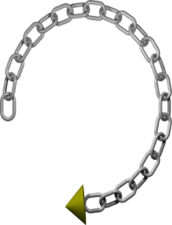



Specifiable, Manageable and Attestable Virtualization Layer
Leverage Trusted Computing technology for Increased Assurance
→ Enabling remote attestation of Invariant Security
Properties implemented in the Trusted Virtualization Layer
Management
Domain
Trusted Virtual Platform
Trusted Virtual Platform
Virtualised
TPM (vTPM)
Banking
Application
Gaming
Application
Software
Integrity
vTPM
vTPM
Trusted Infrastructure Interface (TII)
Physical
Platform
Identity
Firmware
TPM
Notes:
Earlier I said that we want to create a virtualization system that could be attested to, i.e. that we could make a strong statement as to the trustworthiness of it’s current state. So I want to spend a few moments expanding on this.
Explain what a chain of trust is. We want to build systems that are immune from s/w attacks. So we build a chain of trust which is anchored in h/w which gives us a resilience to s/w attacks. It starts with the TPM (crypto device) that is bound to the mother board and we guarantee that this device will be in a known state when initially powered on. Associated with this is a Core Root of Trust for Measurement (CRTM), which is the BIOS boot block code; it can’t itself be measured but it is a piece of code which is considered trustworthy. It reliably measures integrity value of other code, and stays unchanged during the lifetime of the platform. CRTM is an extension of normal BIOS, which will be run first to measure other parts of the BIOS block before passing control. The BIOS then measures hardware, and the bootloader and passes control to the bootloader. The bootloader measures VMM kernel and pass control to the VMM and so on. What you end up with is a chain of trust with a measurement value that can be used for attestation.
TPM stores measurements and can cryptographically report on those measurements to requesting parties (attestation). Essentially, the TPM signs the measurement (which is a cryptographic hash) so that the one asking for the measurement can know that it was measured by a real TPM. The requestor then checks this measurement against a known good value to determine whether or not this system can be trusted.
This is an important feature of these TCG TPMs but one that has yet not been fully exploited. What we are doing within our project is to create an Integrity Measurement and Attestation framework. Specifically designed for measuring the VMM and its supporting security services so that it can attest itself to other platforms that request verification. At its lowest level it will utilize TCG TPM hardware technology and associated CPU / Chipset support such as the Intel (TXT) / AMD (SVM) for DRTM (Dynamic Root of Trust) mechanisms [Grawrock 2006]. Our planned approach diverges from existing integrity measurement systems in regard to its explicit support for the needs of virtualized systems such as chains of trust that can be safely dynamically modified [Cabuk et al. 2008a] and the support for tying the integrity of several VMs together into a single attestable and verifiable entity.
TXT allows us, in combination with the TPM, to ensure that either a Measured Launch Environment or Controlled Launch Environments can be started. MLEs allow any code sequence to run, but generate a launch record which is difficult to forge by an alternative startup sequence. Controlled Launch allows us to refuse to start a particular code image unless the hardware has followed an already approved execution path. We have some functional code which demonstrates MLE, and the functionality to enforce CLE is being developed now.

Slide 32
Security Analytics

Slide 33

Security Analytics
Putting the Science
into Security
Management
Notes:
Most security strategy, policy and investments decisions are based on intuition and best practices.
Security Analytics is about using scientific methods to make security management rigorous and evidence based.
15 September 2010
HP Confidential
33

Slide 34

Complexity, Costs, Threats and Risks are All Increasing
Trying harder is not enough – we have to get smarter
Notes:
We believe this is more necessary as information security gets harder.
With cloud computing, virtualization, consumerization, more business reliance on IT – and pressure on the IT budget - it gets harder to justify any expenditure, and yet with the burgeoning threat environment this must be done.
Yes, we can continue to try harder, but it feels like a change in approach is needed, one where we get smarter – hence security analytics.
15 September 2010
HP Confidential
34

Slide 35
Problems with Security Investments
Security Investments affect multiple outcomes: budget, confidentiality, integrity, availability, …
In most situations these outcomes can only be predicted with high degrees of uncertainty
Often the outcomes are inter-related (trade-off) and the link to investments is poorly understood
Classical business justification/due diligence (Return on Security Investment, cost benefit analysis) encourages these points to be glossed over

Slide 36
Security Analytics
Providing Strategic Decision Support to Decision Makers (e.g. CIOs, CISOs, etc.)
Using Modelling and Simulation to Represent Process, IT Systems, Interactions, Human Behaviours and their Impact on Aspects of Relevance: Security Risks, Productivity, Costs
Carry out “What-If” Analysis and Make Predictions, based on Alternative Investments, Threat Environments, etc.

Slide 37

Security Analytics:
Integrating Scientific Knowledge
Security/Systems
Domain knowledge
Economic Theory
(utility, trade offs,
externalities, information asymmetry, incentives)
Applied
Mathematics
(probability theory,
queuing theory,
process algebra,
model checking)
CISO / CIO /
Business
Empirical Studies
(Grounded theory,
discourse analysis,
cognitive science)
Experiment and Prediction
(Discrete event modelling
and simulation)
Business Knowledge
Notes:
Today most security teams have good knowledge about IT and are working hard to align this with business knowledge.
We are looking to take this further to make business aligned security decisions based on simulation and prediction. To support this we are using appropriate economic and mathematical tools
15 September 2010
HP Confidential
37

Slide 38
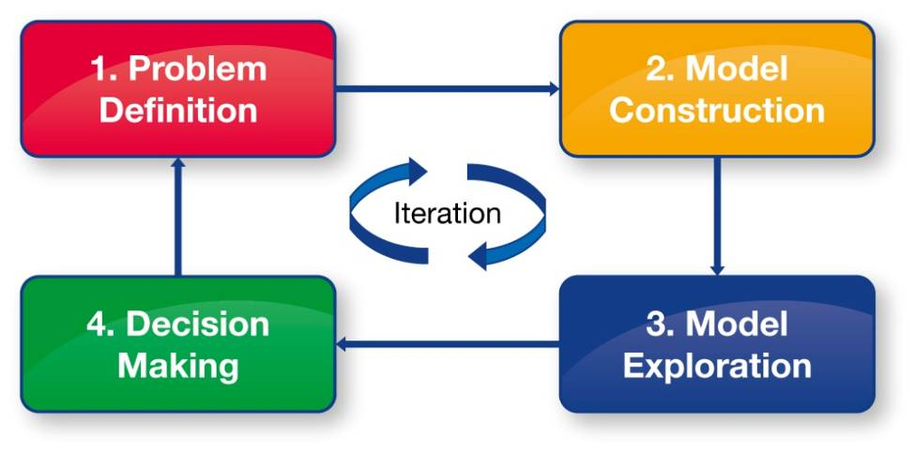
PACKAGED SECURITY ANALYTICS
Transforming security management to one based on scientific rigor
Launched at Infosec 2010 as part of Security Business Intelligence
Based on VTM/IAM case studies
Iterative engagement approach to define the problem and explore possible solutions and their tradeoffs
Generation of full report
→ Application of Security Analytics to Cloud Stewardship Economics
Notes:
This is part of an ongoing ambitious research programme, and our first deliverable is to offer a packaged Security Analytics services engagement, together with the tools and methodology, for both Vulnerability and Threat Management, and also for Identity and Access Management.
Starting with an initial workshop to explore your unique security challenges and identify the strategic priorities, appropriate models will be created and explored to determine the possible outcomes of key security decisions which are available to you. At the end of the exercise you will receive a full report documenting the challenges addressed, the options explored and conclusions drawn.
15 September 2010
HP Confidential
38

Slide 39
Cloud Stewardship Economics

Slide 40
UK Government Founded Collaborative Initiative
Cloud Stewardship Economics:
  Economics & System Modelling -> Cloud Eco-Systems
  Aberdeen University, Bath University, IISP, Lloyds of London, Marmalade Box, Sapphire, Validsoft
Source & Contacts: HP Labs, Systems Security Lab (SSL), Bristol, UK – Simon Shiu, Adrian Baldwin

Slide 41
The Cloud Ecosystem
Consumer
Enterprise
Small Business
Government
Department
Pure Service Consumers
Bundled Portal aa
Service
Service Consumer/ Providers
CRM aa
Service
Comms aa
Service
CPU Service
Secure Archive Storage Service
Infrastructure Service
24*7 Available
Storage Service
Pure Service Providers

Slide 42
Stewardship in the Cloud Ecosystem
Consumer
Enterprise
Small Business
Government
Department
requirements
expectations
Procurement & Consuming
Bundled Portal aa
Service
Confidentiality
Integrity
Availability
incentives
CRM aa
Service
Comms aa
Service
Procurement & Consuming
Obligations
preferences
CPU Service
Secure Archive Storage Service
Infrastructure Service
24*7 Available
Storage Service

Slide 43
Summary of Cloud Stewardship Issues
Cloud
  Multiple stakeholders
  Complex Supply Chains
  Procurement Challenges
Stewardship
  Where information is
  Who is accountable, and responsible
  Who can see or change information
  Assurance
  Liability (with longevity)

Slide 44
Cloud Ecosystem Economics
Key ideas that are guiding our empirical work
Micro Economics
  Information Asymmetry
    As the service provider I know more about the costs and risks of handling your data than you or any regulator
  Externalities; Public/Club Goods
    Being secure costs me more than I gain, even though others in the community gain too.
  Heterogeneity of services & users
    How do we value bundled security characteristics & develop associated product and pricing strategies
Macro Economics
  Aggregate drivers and effects
… As well as applying preference, utility, system modelling to this context

Slide 45
Privacy Management

Slide 46
Privacy Management
TSB EnCoRe Project
- EnCoRe: Ensuring Consent and Revocation
UK Government Collaborative Project – http://www.encore-project.info/
“EnCoRe is a multi-disciplinary research project, spanning across a number of IT and social science specialisms, that is researching how to improve the rigour and ease with which individuals can grant and, more importantly, revoke their consent to the use, storage and sharing of their personal data by others”
- Problem: Management of Personal Data (PII) and
Confidential Information driven by Consent & Revocation
Contact: HP Labs, Systems Security Lab (SSL), Bristol, UK – Pete Bramhall

Slide 47
EnCoRe:
Enabling the Flow of Identity Data + Consent/Revocation
On Demand
CPUs
Printing
Service
CRM
Service
Identity Data & Credentials
+
Consent/Revocation
Office
Apps
Identity Data & Credentials
+
Consent/Revocation
Data
Storage
Service
User
Delivery
Service
Cloud
Provider #1
Identity Data & Credentials
+
Consent/Revocation
Enterprise
Identity Data & Credentials
+
Consent/Revocation
Enterprise
Backup
Service
Cloud
Provider #2
ILM
Service
Service 3
…
…
The
Internet
…

Slide 48
EnCoRe:
Explicit Management of Consent and Revocation
Cloud
Provider #1
EnCoRe
ToolBox
On Demand
CPUs
EnCoRe
ToolBox
Printing
Service
CRM
Service
Office
Apps
Data
Storage
Service
User
EnCoRe
Toolbox
EnCoRe
ToolBox
…
Cloud
Provider #2
EnCoRe
ToolBox
Enterprise
Enterprise
Backup
Service
EnCoRe
ToolBox
ILM
Service
Service 3
…
…
The
Internet
…

Slide 49
EnCoRe Project
Various Case Study:
  Enterprise Data
  Biobank
  Assisted Living
Press Event: 29/06/2010
http://www.v3.co.uk/v3/news/2265665/hp-working-privacy-tool
http://finchannel.com/Main_News/B_Schools/66174_LSE%3A_Turning_off_the_tap_for_online_personal_data_-_prototype_system_unveiled_by_EnCoRe_/
Technical Architecture and Solutions available online:
http://www.encore-project.info/

Slide 50
Outline
Background on Cloud Computing
Impact on Enterprise’s Security Lifecycle Management
Current Trends, Requirements and Cloud Computing Initiatives
Future Directions: related R&D Work by HP Labs
Conclusions

Slide 51
Conclusions
Cloud Computing is Happening Now
Different Drivers and Needs – but Cost Cutting is currently Dominating
Different attitudes and risk exposures based on type of Companies (SMEs, Medium-large Enterprise, Government Agencies)
It is not really a Matter of Technology
Little understanding of the overall Security, Trust and Privacy Implications
Need for more Assurance, Accountability and Transparency

Slide 52
Q&A
More Information:
Marco Casassa Mont, HP Labs, marco.casassa-mont@hp.com
http://www.hpl.hp.com/personal/Marco_Casassa_Mont/

